Slide 1
Kanban for Lean Agile Development
A Practical Approach (In theory!)
Victor J. Grazi,
Nomura America

Slide 2
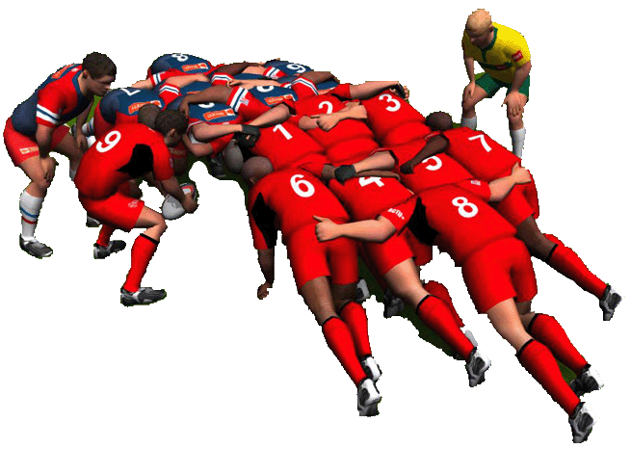
Agile “Scrum” Process
Short Iterations
Frequent deliverables
Early feedback
Measurable velocity
Notes:
Scrum is a quantum improvement over waterfall, but there are challenges with a large distributed team…

Slide 3

Scrum Shortcomings
Difficult to handle multiple iterations at once.
What do you do when you’re finished before the sprint?
Iteration meetings are taxing and require heavier project management overhead.
Limits the flow of new items into the system.
But that’s not all…
Notes:
In general scrum teams frequently run off on their own until the end of the sprint, and there is little insight into progress between the beginning and the end of the sprint.
In case there are multiple concurrent versions, it is difficult to prioritize across those versions.

Slide 4
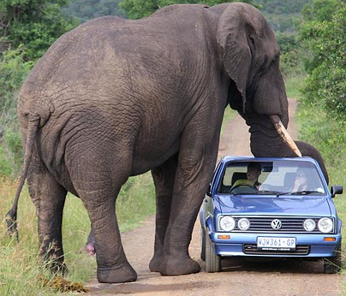
…some things just don’t fit into an iteration!
Notes:
Kanban establishes an individual cadence for recurring events, rather than squeezing everything into a time boxed iteration
For example, scrums happen daily. UAT happen bi-monthly, Retrospectives happen monthly, etc. Not everything has to happen around the timing of a sprint.

Slide 5
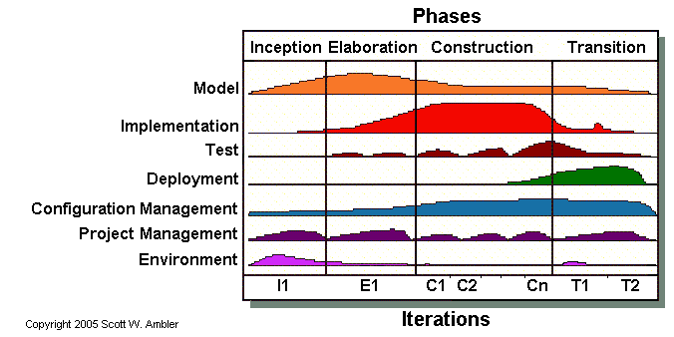
…iterations have humps
Phases
Iterations
During early phases, analysts are busy.
During construction, developers are busy.
During Testing, QA is busy.
How can we smoothen the humps?
Notes:
Also, there is little guidance about how to flatten the humps that occur during the various stages of development. And there is little flexibility in modifying those stages to accommodate your process

Slide 6
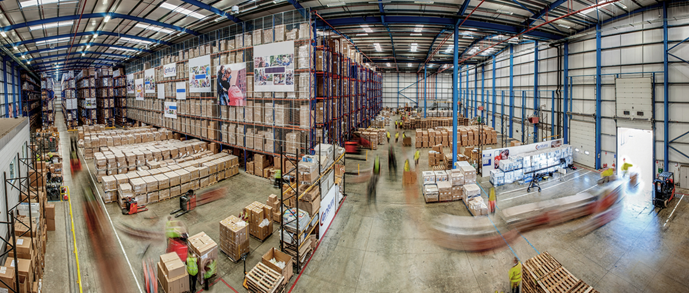
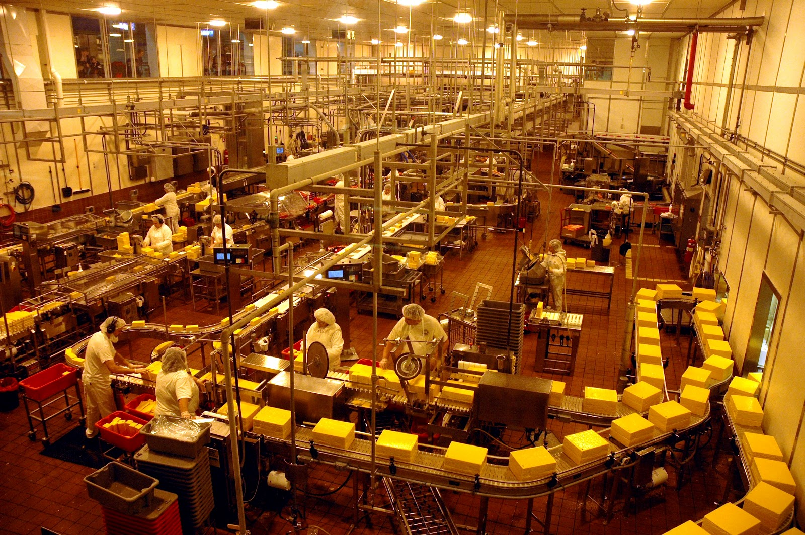
In a traditional factory it was easy to visualize the flow of work…
Traditional Flow Visualization
6/

Slide 7


Knowledge Workers Look Alike!
But in a software shop, every desk looks the same.

Slide 8


Enter Kanban
In Japanese the word “kan” means "signal" and "ban" means "card“.
A Kanban card is a signal that triggers action.
Kanban is a “continuous flow” system. No iterations!
When there is available throughput at any column, workers pull from the previous column.
Kanban is everywhere!
(Even Starbucks!)
8/
Notes:
When the server says “next” she is “pulling” an item into her swim lane. That is Kanban

Slide 9
Kanban Principals
Visualize your work.
Limit Work in Progress.
Manage flow left to right (signal when new work can be pulled through the system.)
Make management policies explicit (e.g. lead times, cycle times, WIP limits, etc.)
Implement feedback mechanisms from right to left.
Notes:
DevOps Handbook
Visualize
Manage the flow left to right
Increase the feed back left to right

Slide 10
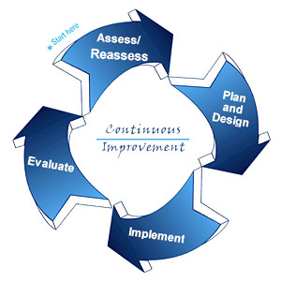
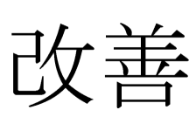
Kaizen
Kaizen: Japanese for “change for the better”.
Process that strives to continuously improve itself.
Fundamental to Kanban.

Slide 11
Lean vs. Kanban
Lean – Software Development Principles for eliminating waste
Kanban – Lean software development process for optimizing flow
11

Slide 12
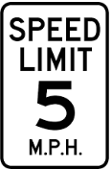
Seminal Kanban Principal
Limit Work in Progress
(WIP)
WIP

Slide 13

Multitasking
(v.) The art of screwing up several things at once.
13

Slide 14


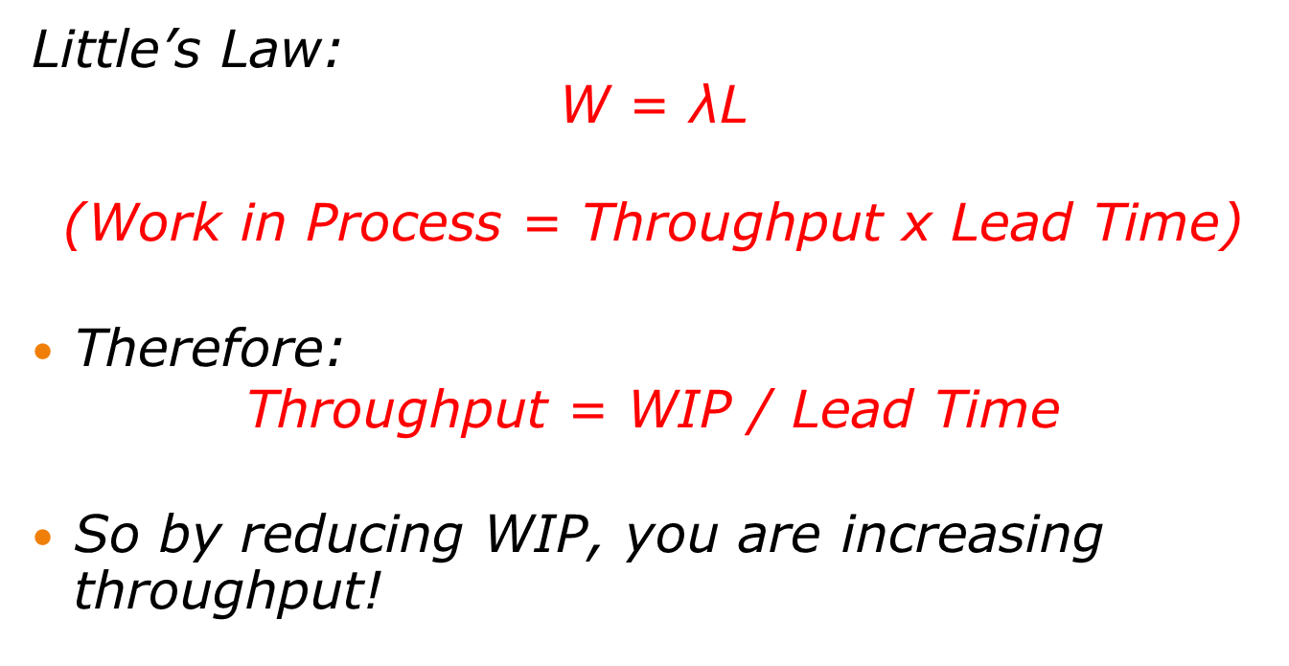
Little’s Law
Little’s Law: $$\text{W}\text{ = }\text{λ}\text{L}$$
$$\text{(}\text{Work} \text{in} \text{Process}\text{ = }\text{Throughput} \text{x} \text{Lead} \text{Time}\text{)}$$
Therefore:
$$\text{Throughput}\text{ = }\text{WIP}\text{ / }\text{Lead} \text{Time}$$
So by reducing WIP, you are increasing throughput!
To do | In Process | Done
* * *
* * * *
14

Slide 15
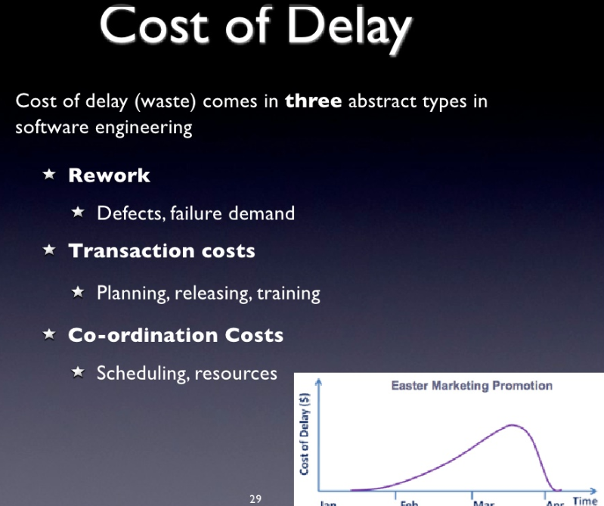
Little’s Law
15

Slide 16
Visualize your work

Slide 17
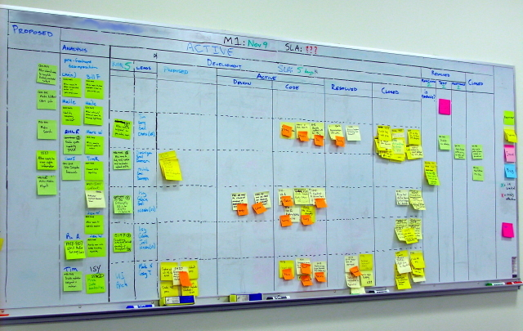
Kanban Board Provides Visualization of Work In Progress

Slide 18
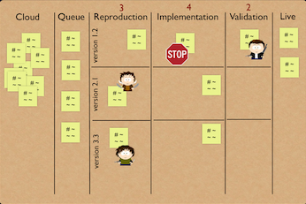
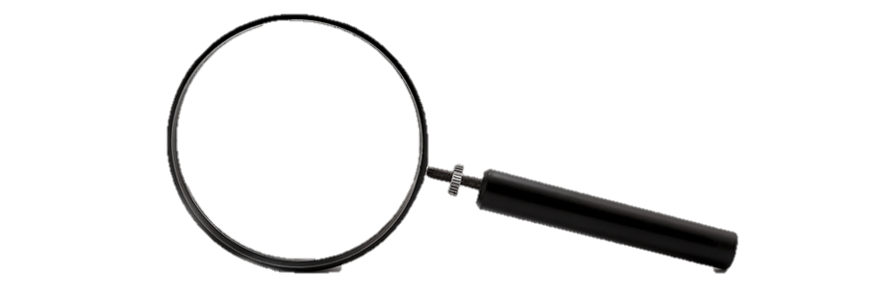







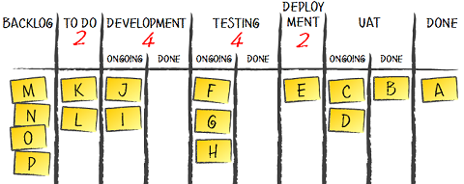
Daily Scrums at the Kanban Board
Story cards have developer avatars
Red post-its indicate “blocked”
4 3 4 2
Backlog Design Build Test Deploy Live
JIRA XYZ Implement Undo
Build In: Nov 4
Out: Nov 12
Test In: Dec 1
Out:
Database Back End UI

Slide 19
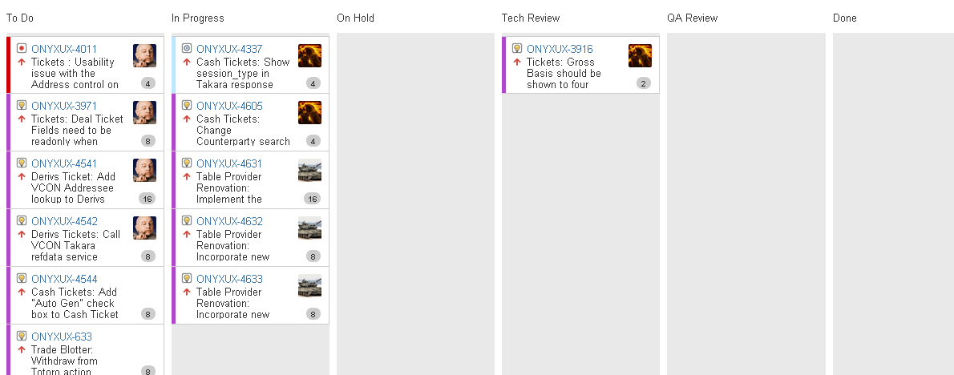
Jira Kanban Board
Plan the Known

Slide 20
Why Pull?
So that you:
Don’t write more specs than you can code
Don’t write more code than you can test
Don’t test more code than you can deploy
Don’t build features that nobody needs right now!
Backlog | Plan (3) | Develop (3) | Etc. (4) | Done
Flow
20
Notes:
Slide 18 https://kanbantool.com/kanban-library/implementing-kanban/pulling-value-lean-and-Kanban

Slide 21
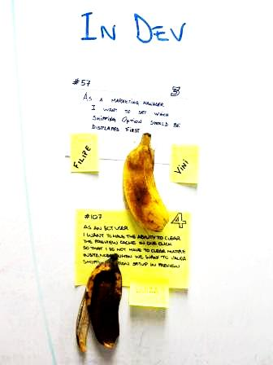
Kanban Board
Ensure that tasks are moving towards
completion and not getting stale.

Slide 22
Concurrent Release Cycles
So instead of this…
You have concurrent release cycles
Plan
Dev
Test
Deploy
…
Plan
Dev
Test
Deploy
…
...
1
2
3
4
5
6
7
8
9
10
11
12
P
D
D
QA
GO
P
D
D
QA
GO

Slide 23
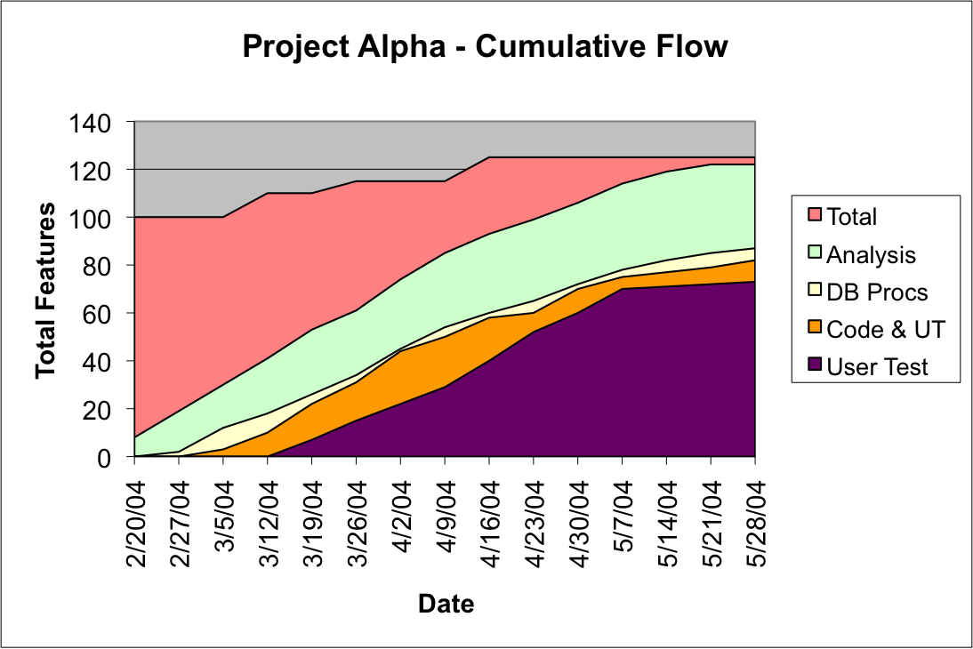
Cumulative Flow Diagram

Slide 24
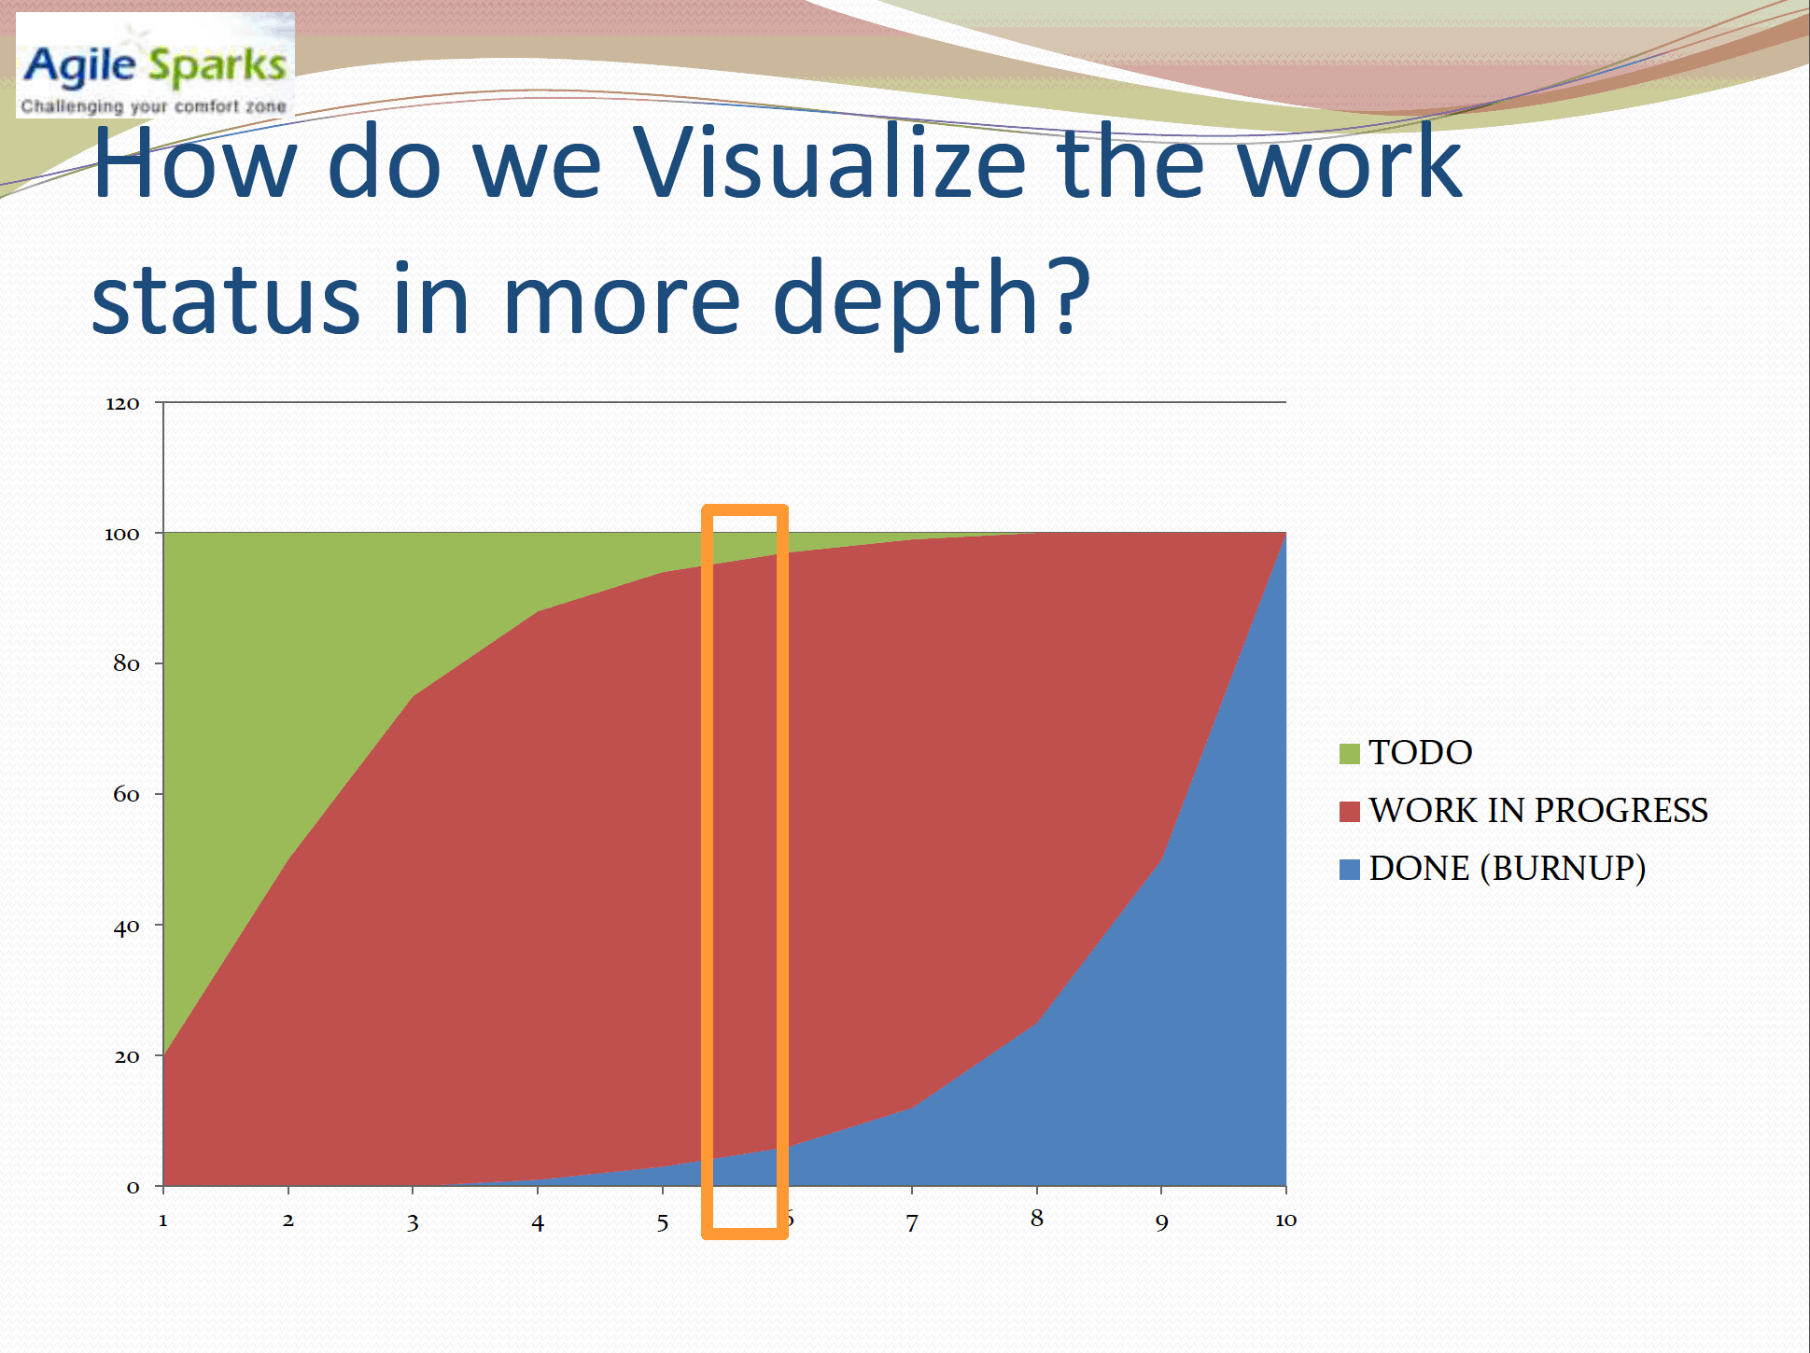

Slide 25
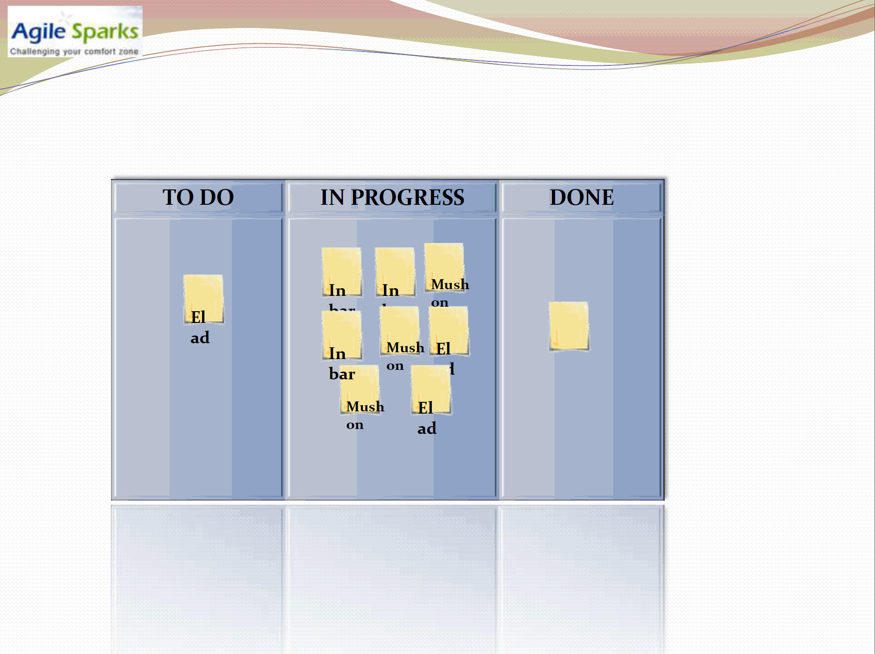

Slide 26
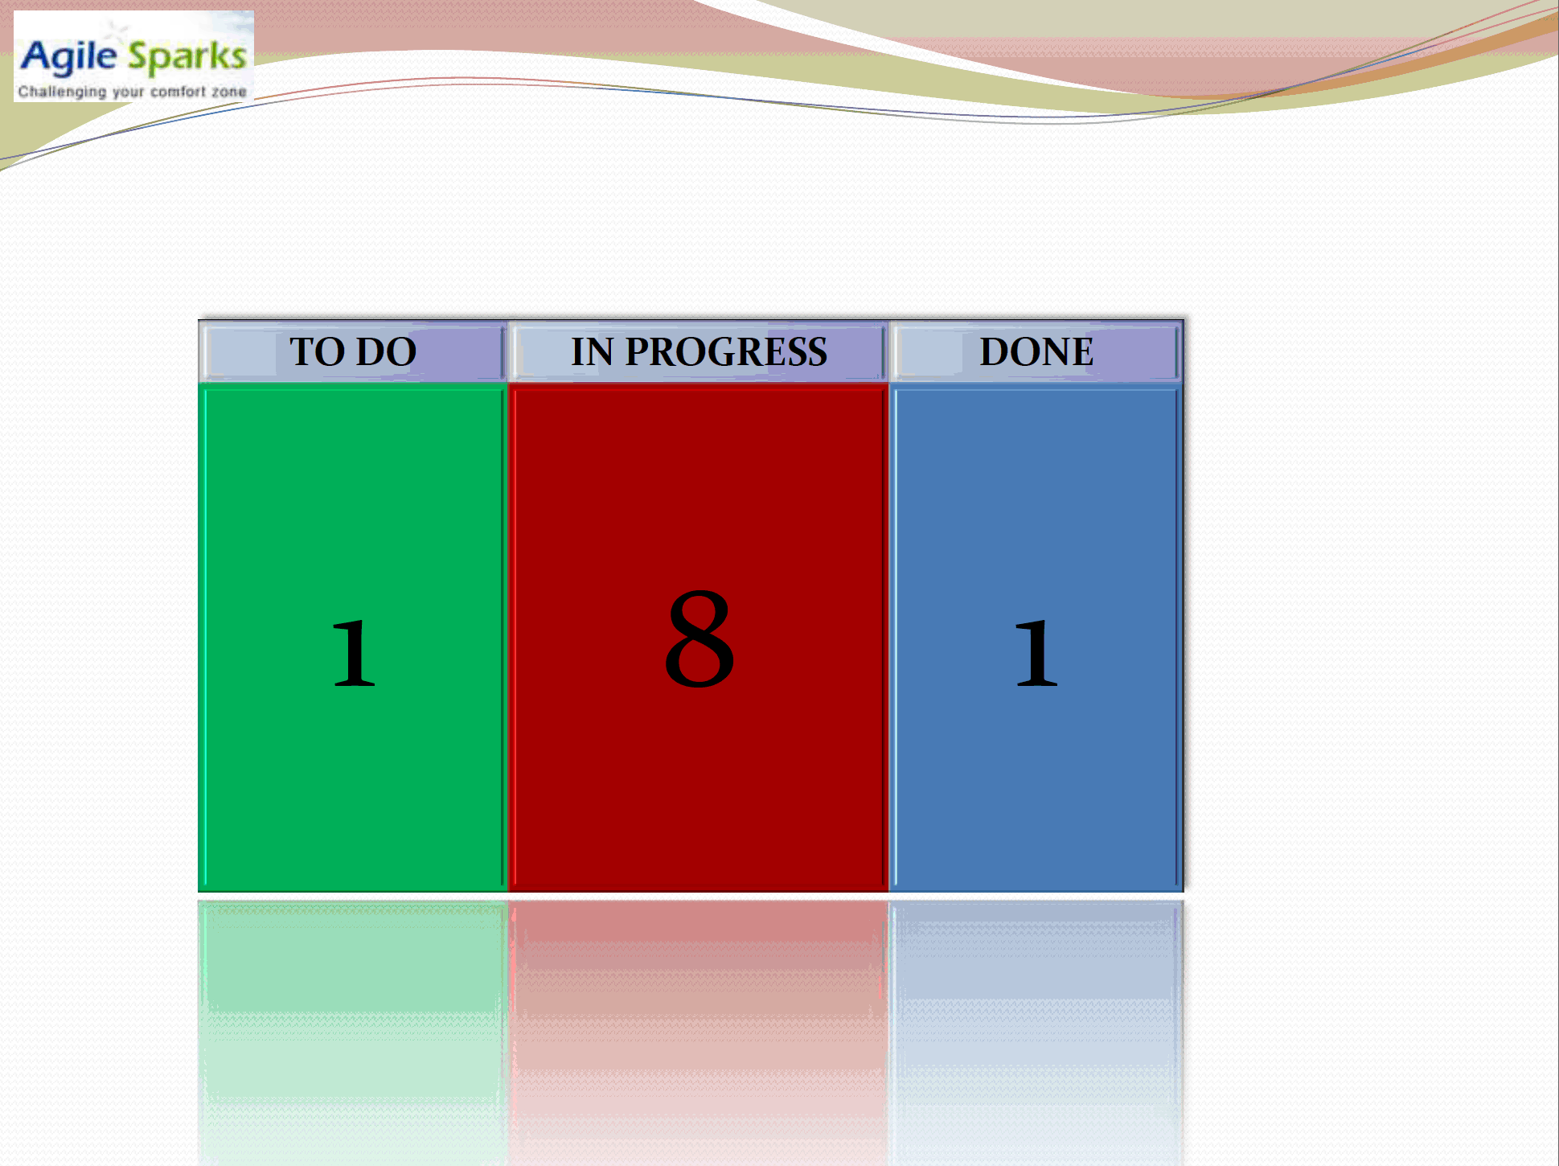

Slide 27
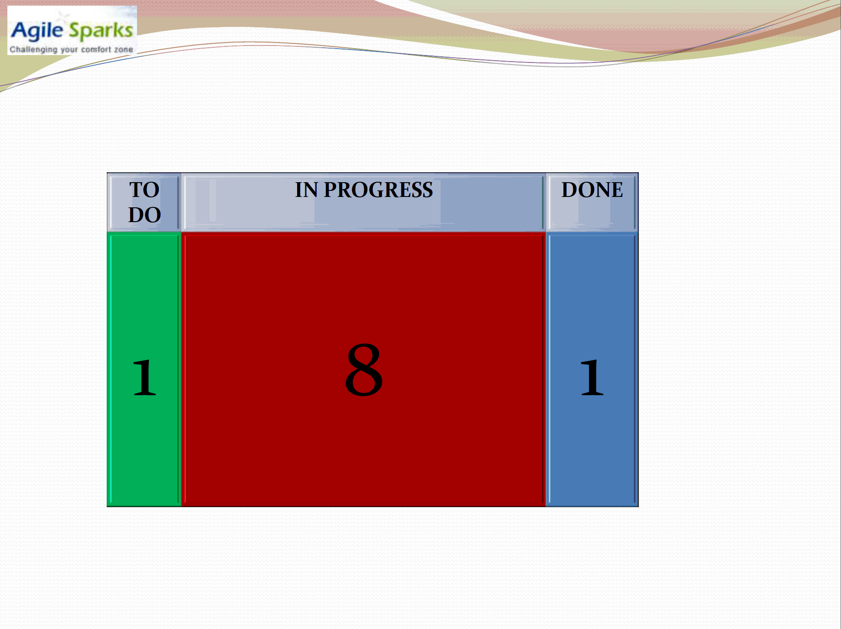

Slide 28
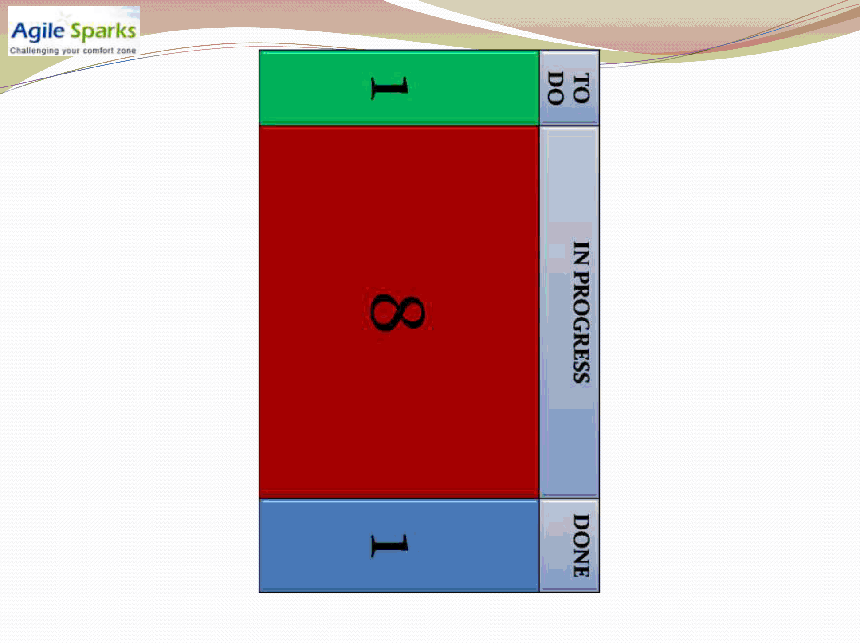

Slide 29
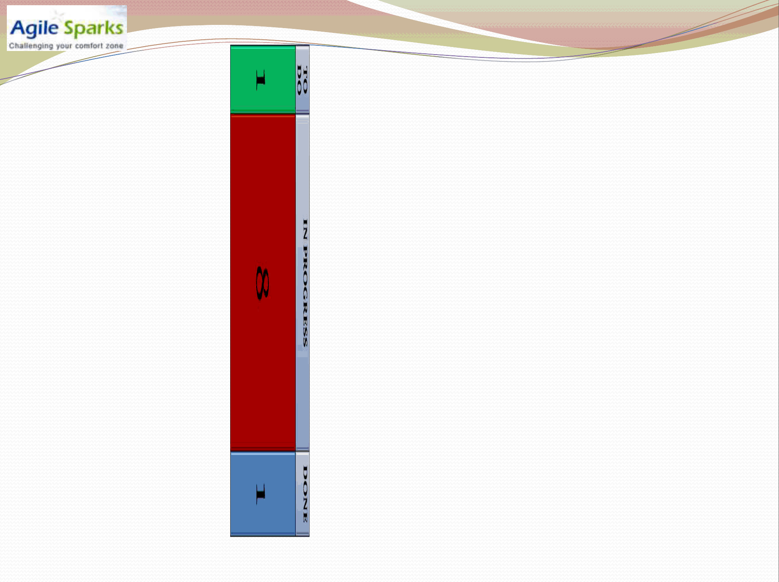
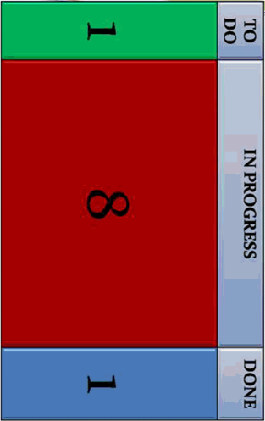

Slide 31
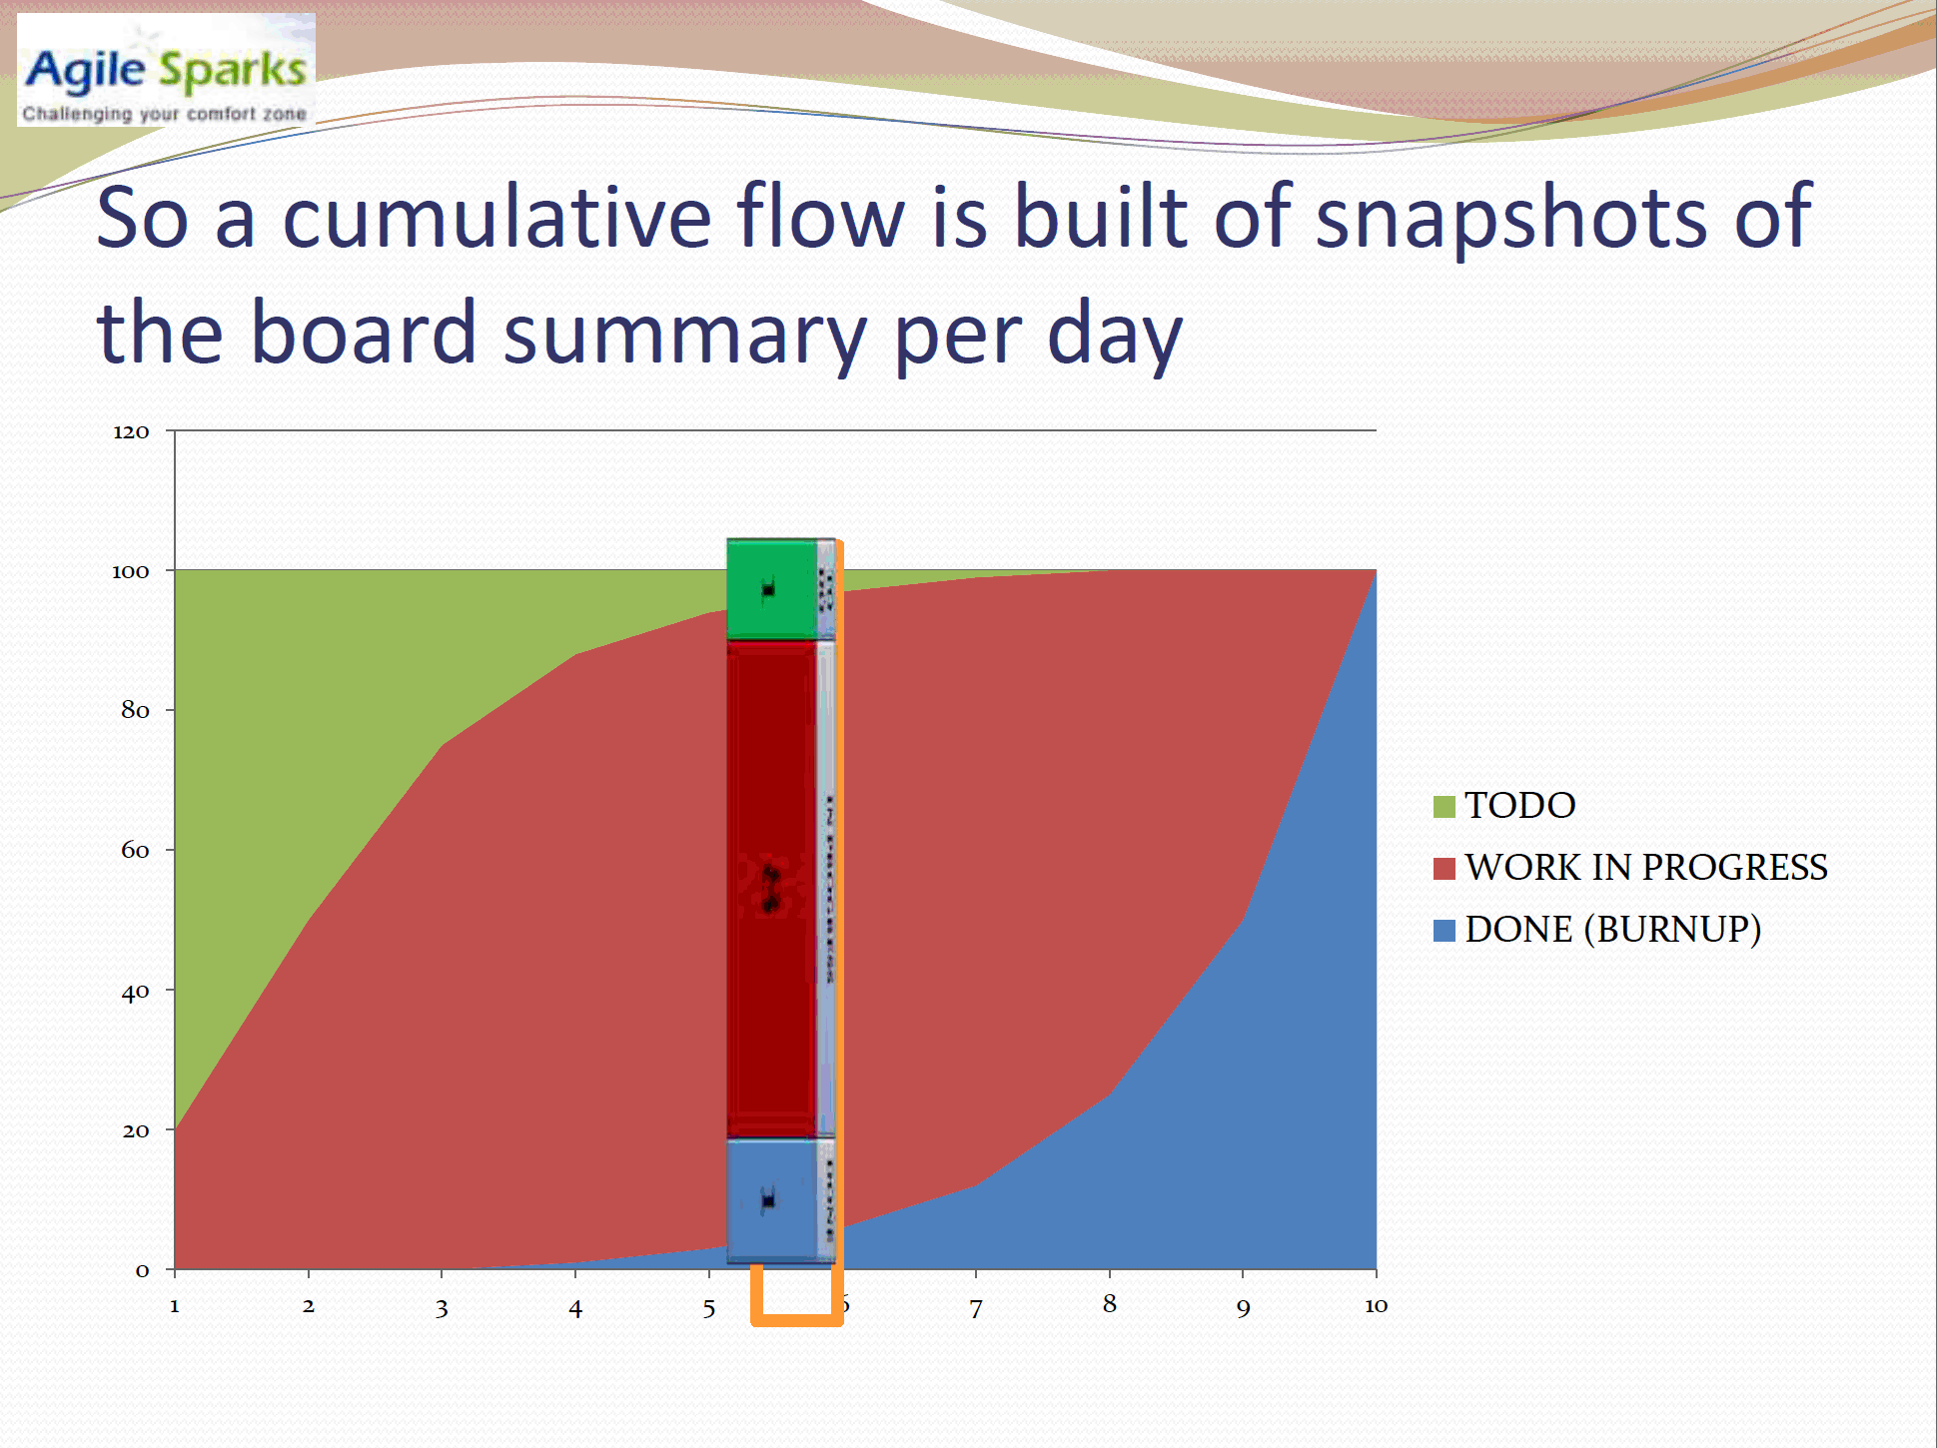

Slide 32
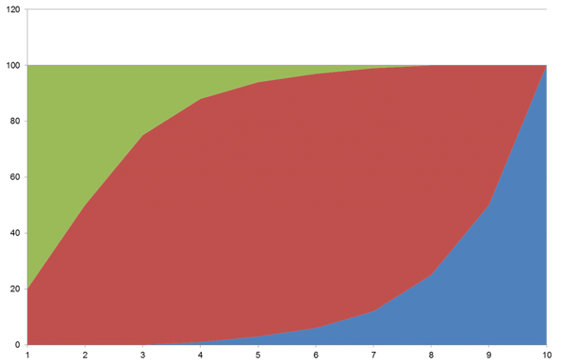
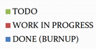
Cumulative flow diagram is built of board snapshots per day

Slide 33
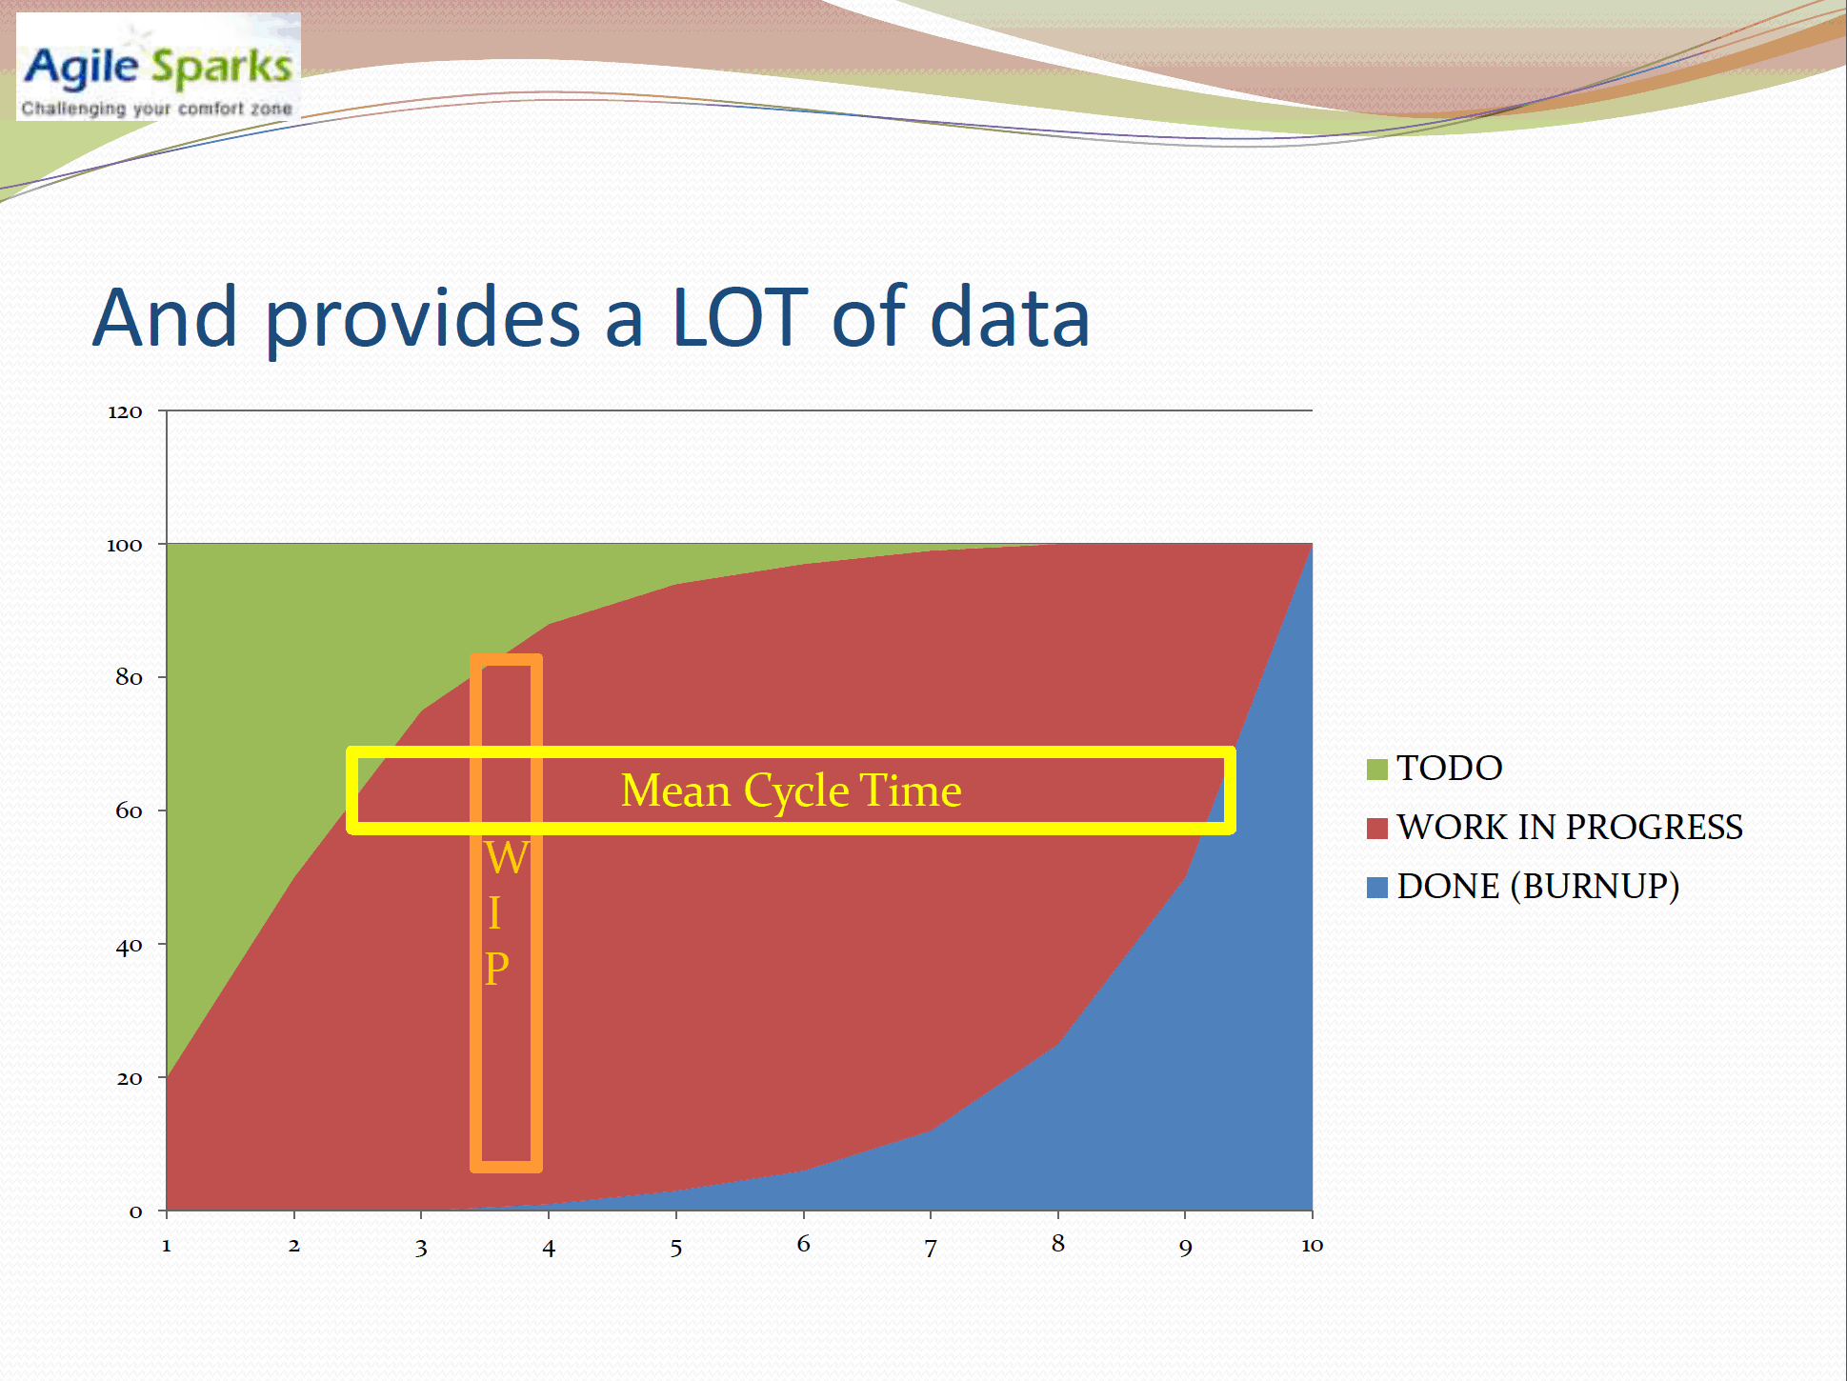

Slide 34
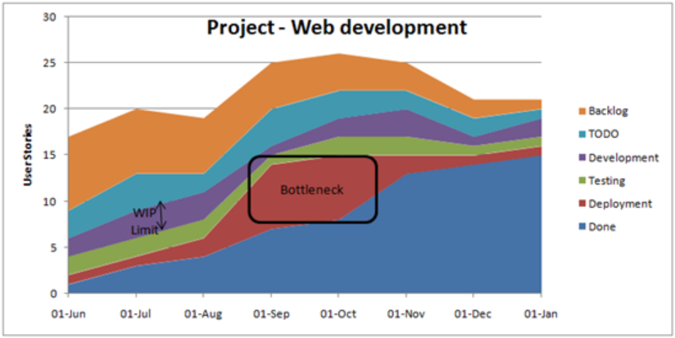
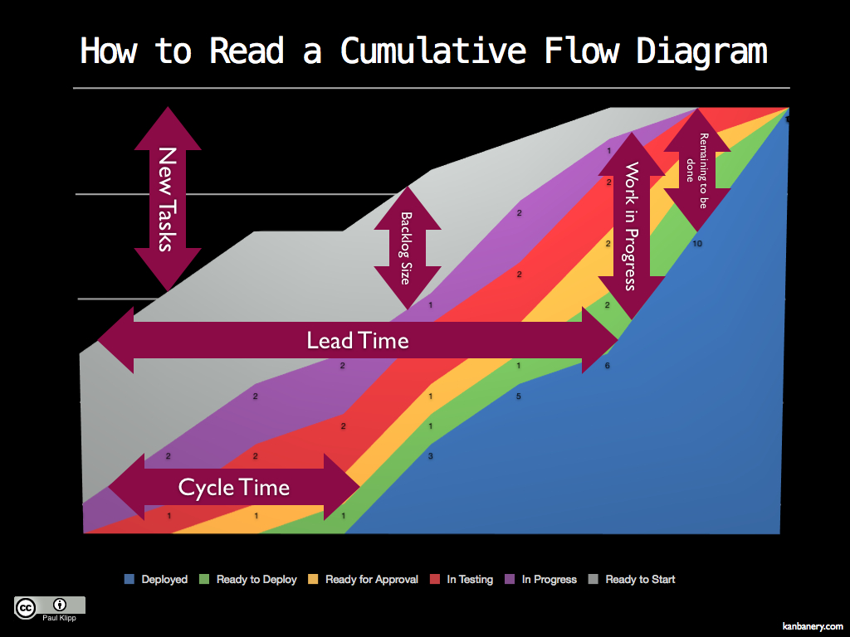
Cumulative Flow Diagrams
Cumulative Flow Diagram highlights hot-spots.
Colored bands represent columns on the Kanban board.
Bulges in width represent too much time in that column.
Notes:
Insert Yuval Yeret’s slides here, convert to animation

Slide 35
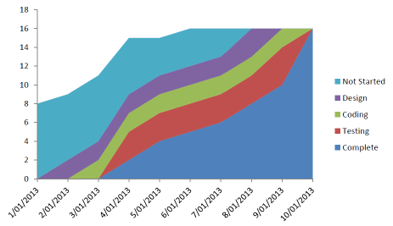
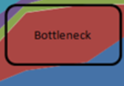
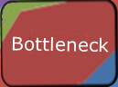
Cumulative Flow Diagrams
Backlog
Remaining
New Tasks
Cycle Time
Item Count
Lead Time
Time
Ready to start
In Progress
In Testing
Code Complete
Deployed
Colored bands represent columns on the Kanban board.
Bulges in width represent bottlenecks…too much time in that column.
Notes:
Insert Yuval Yeret’s slides here, convert to animation

Slide 36
Cumulative Flow Diagram Best Practices
For the CFD to be accurate, maintain the Kanban board accurately
Appoint a scrum master who’s job is to keep the board current
Have daily scrum meetings to discuss work in process

Slide 37
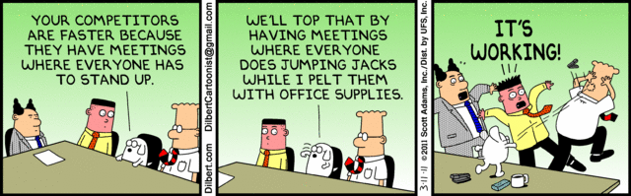
Daily “scrum” meetings encourage accurate metrics and continuous feedback
Notes:
Scrum is a quantum improvement over waterfall, but there are challenges with a large distributed team…

Slide 38
Goldratt’s Constraint theory
Identify the Constraint
Remediate
If persists, escalate
Repeat the Process
Review

Slide 39
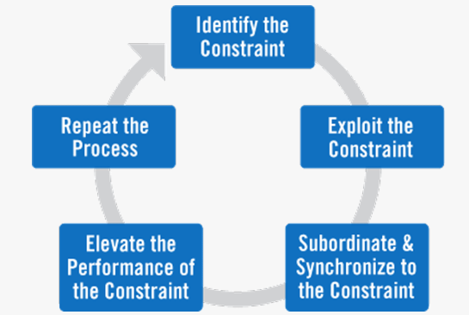
Goldratt’s Constraint theory
There is always one critical constraint in a system
If you optimize things before that, you will produce a bottleneck at the constraint
If you optimize the things after, nothing will reach there!
Agile Coach should help identify the bottlenecks
39/

Slide 40
In Summary
Kanban flattens humps associated with scrum.
Kanban encourages smoother flow of stories through the system.
Simple system encourages participation.
Studies report high return on investment.
Kanban is not a big change from the current system but it has big effects.
Kanban can be laid over other agile processes such as scrum, as a starting point.

Slide 41
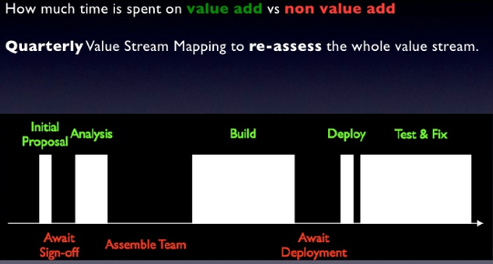
Mapping the Value Stream
Notes:
Slide 16 https://kanbantool.com/kanban-library/implementing-kanban/pulling-value-lean-and-Kanban

Slide 42

I am Kanban
Start with what you are already doing
Map your process to a Kanban board
Assign Agile Coach(es)
Implement pull
Assign WIP limits based on team size
Pull when a column has available capacity
Daily meetings ensure things are flowing
Kaizen - Retrospect often and tweak
Evolve

Slide 43
Onyx UX Development Agile with Kanban
A Case Study
Robb Keayes and Eileen Changsut
Nomura America

Slide 44
ONYX UX Distributed Dev Team
Three Silos: Trade Capture, Risk and Gator
Business Product Owners: Andrew Pearson – TC, Andrew Watkins – Risk, Yogesh Mishra - Gator
Global Technical Product Owner: Bruce Davis
Product Management Team:
UX Development – Robb Keayes, Adriana Curelariu, Nrupal Desai
Server Development – Soumyendu Pal/Martin Price, James Shute/John King, Yogesh Mishra
BA’s - Michael Webb, Allison Doyle, Matt Long, Ben Wells, Dhawal Sinha
UX Development Team:
5 developers in New York
4 developers in London
2 developers in India
2 developers in Tokyo
7 developers in Shanghai
1 Dedicated Graphic Designer in Shanghai
4 QA team members in Shanghai, India, NY, LN
44/

Slide 45
Onyx TC Development
Business Product Owner: Andrew Pearson
Product Management Team:
UX Development – Robb Keayes
Server Development – Soumyendu Pal, Martin Price, Yogesh Dawalbhakta
BA’s - Michael Webb, Allison Doyle, Matt Long, Roman Geistrikh
Development Team
2 developers in NY
2 developers in London
2 developers in Mumbai
2 developers in Tokyo
~3 developers in Shanghai (rotating)
4 QA team members in Shanghai, Mumbai, NY, LN

Slide 46
If at first….
Take 1
What we did initially
Scrum – pre-planned development
Kanban – ad-hoc BAU requests, QA issues, urgent bugs

Slide 47
One Release Cycle
The Onyx Development Process
Each release is 8 weeks long:
1 week planning
4 weeks development – 2 sprints
2 weeks QA and UAT
1 release week - CAB, deployment
1 2 3 4 5 6 7 8
Plan
Dev
Dev
QA
GO

Slide 48
Concurrent Release Cycles
The Onyx Development Process
1 2 3 4 5 6 7 8 9 10 11 12
Plan
Dev
Dev
QA
GO
Plan
Dev
Dev
QA
GO
.
.
.
1
2
3
4
5
6
7
8
9
10
11
12
P
D
D
QA
GO
P
D
D
QA
GO

Slide 49

Calculated and Expected
The Sprint

Slide 50
Tell them what you’re going to do
The Sprint
Each sprint is 2 weeks long
2 sprints per release cycle
Occur ‘just in time’; developers roll onto the next sprint when the previous one ends
QA issues from previous release impact first sprint of next release

Slide 51


Requirements that are New, Missed, Changed….
Feedback Happens

Slide 52
The Kanban board is born!
What to do?
Put items in your backlog? But you don’t know when you will start them!
Add them to your sprint? You don’t know when you’ll end them! Hmmm!
OR…
Create a separate place to store urgent “new requirements” ☹
Social contract: Best Effort. Blockers go to the top!

Slide 53

Ad-hoc and Unexpected
The Kanban

Slide 54
The Sprint Board
Plan the Known

Slide 55
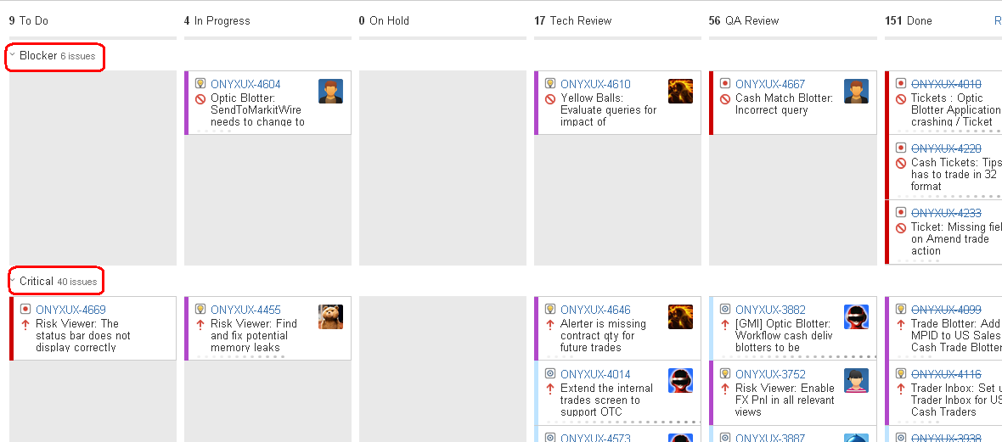
The Kanban Board
Manage the Unknown

Slide 56
Lions! Tigers! Bears! Oh My!
In reality
Sprint – many planned commitments
+
Kanban – many unplanned commitments
In financial IT, BAU is a fact of life
(Sprint + Kanban) = (Chaos + Stress)

Slide 57
Try again…
Take 2
All Kanban all the time
With rules across the columns
Rule breaking stops all other processing
“Onyx Bugs”
Inputs - Bugs, BAU, QA, requirements
The Backlog
Prioritized “what’s next” list
Kanban Board

Slide 58
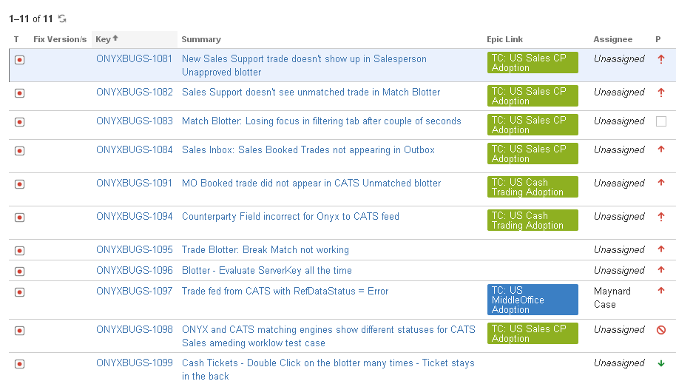
.. is the Hopper
The Onyx Bugs List…

Slide 59
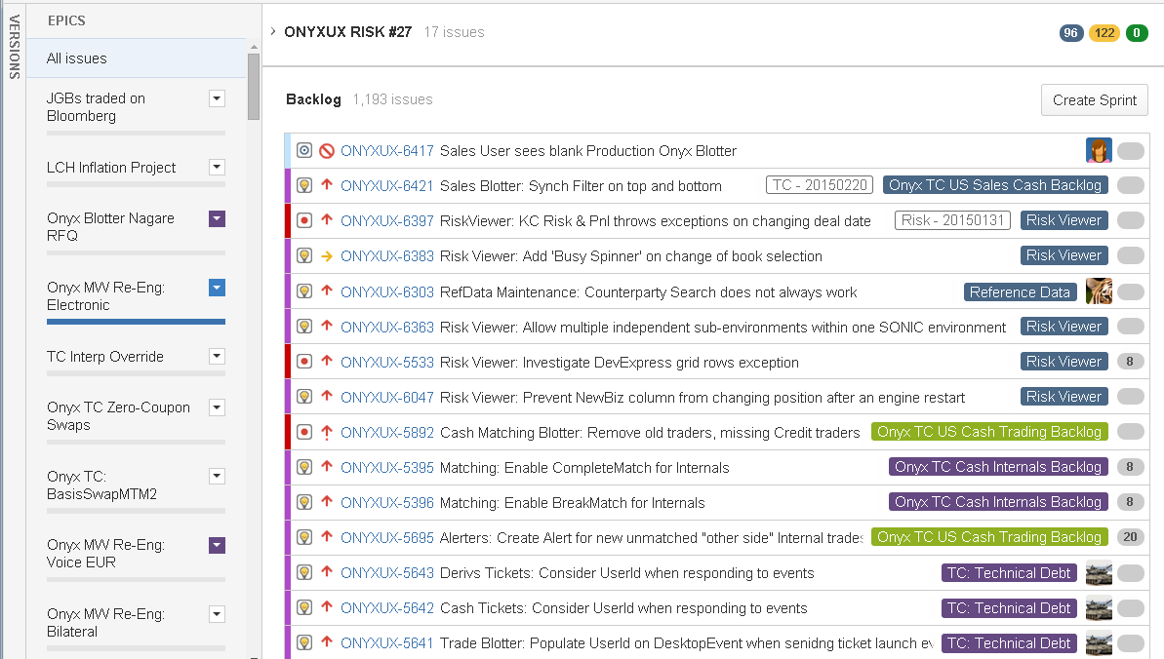
... is The Conveyor Belt
The Backlog…

Slide 60
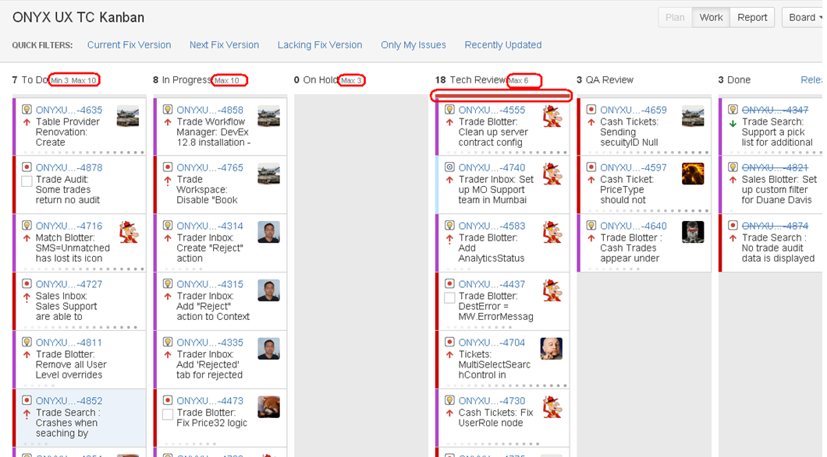
... Is the Work in Progress
The Kanban Board…
Violation 18 vs 6
Min and/or Max
Violation turns
Column red

Slide 61
Speaker series
Tout your products
Encourage reuse
Foster camaraderie
Increase your performance rating
Contact me (Victor Grazi)
(and your bonus ☺)

Slide 62



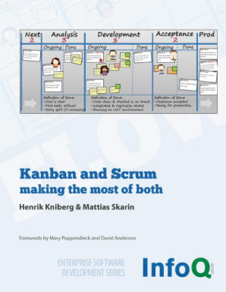
References
Kanban: Successful Evolutionary Change for Your Technology Business – The Kanban Bible, more philosophy than technique.
Personal Kanban: Mapping Work | Navigating Life – A good first look at Kanban process and philosophy, for managing personal tasks.
Lean from the Trenches: Managing Large-Scale Projects with Kanban – Practical steps for one project’s implementation of Kanban across 1 or more teams.
Kanban and Scrum - making the most of both (Enterprise Software Development) - Guide for a smooth transition.
Kanban Dev Mail List: http://finance.groups.yahoo.com/group/kanbandev
Limited Work In Progress Society
Notes:
Personal Kanban is a fast read and covers the basics. Lean from the Trenches is one teams approach to Kanban.

Slide 63
More Assorted References
Leading Lean Software Development, Tom and Mary Poppendieck (http://www.amazon.com/Leading-Lean-Software-Development-Results/dp/0321620704/)
Cumulative Flow Diagrams presentation by Yuval Yeret http://www.slideshare.net/yyeret/explaining-cumulative-flow-diagrams-cfd
More on Charts in Kanban pm.stackexchange.com http://pm.stackexchange.com/questions/622/useful-charts-for-a-kanban-system) Look at the first answer and in particular the attached image.
Karl Scotland has a nice overview here: http://availagility.co.uk/2008/10/28/kanban-flow-and-cadence/ Cool explanation of lead time vs. cycle time http://leanandkanban.wordpress.com/2009/04/18/lead-time-vs-cycle-time/
Notes:
These references are shorter and quite excellent

Slide 64
And now, it’s Retrospective time!
Backlog | Plan (3) | Develop (3) | Etc. (4) | Done
Questions?

